Slide 1

APPLIED PHYSICS
BY KEVIN NICHOLS
TECH204 Final Course Project

Slide 2
Introduction
Over the course, you'll explore how trigonometry connects to linear motion, and how forces affect motion using Newton's Laws. You'll study how energy and momentum are conserved, and how circular motion works. You'll also learn the basics of electricity and magnetism, including electric and magnetic fields, forces, and induction. Later, you'll evaluate different types of waves like light and sound. Briefly describe each project.

Slide 3
TECH204
Project Part 1
Inventory of Parts and Software

Slide 4
Ultrasonic Sensor HC-SR04
Describe the working principles of ultrasonic sensors in detail.
  Answer:
  The HC-SR04 ultrasonic sensor uses the principle of echolocation. It sends out a high signal (5V) and has a sensor and microcontroller that measure the duration of the signal from when it is sent to when it is received, using precise time measurements.

Slide 5
Rotary Encoder KY-040
Describe the working principles of rotary encoders in detail.
  Answer:
  The KY-040 rotary encoder detects rotation using two signal pins (A and B) that output square waves. It has a sensor and microcontroller that measure the order and timing of these signals to determine the direction and amount of rotation. The encoder also includes a button switch that activates when the shaft is pressed.

Slide 6
Hall Effect Sensor in ESP32
Describe the working principles of the Hall Effect Sensor in detail.
  Answer:
  The Hall Effect sensor in the ESP32 detects magnetic fields using a built-in sensor and microcontroller. When a magnetic field is present near the sensor, it generates a voltage that the microcontroller measures to determine the field’s strength. This change in voltage is used to detect the presence, proximity, or rotation of a magnetic object. The sensor allows for contactless and reliable magnetic field detection.

Slide 7

Screenshots
What tool will you used to take screenshots? How does it work?
  I will be using Microsoft's Snipping Tool.
  It works by clipping the current image on the screen.

Slide 8
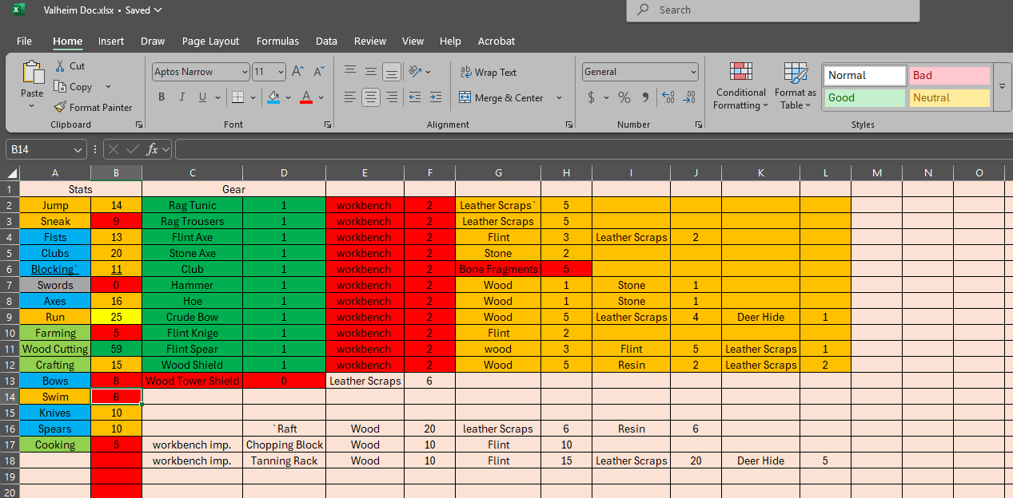
Required Software
Screenshot of Microsoft Excel installed and running on your computer

Slide 9
TECH204
Project Part 2
Precision of the Ultrasonic Sensor

Slide 10
Data Collection
Trial | Ruler Distance (cm) | Total Roundtrip Distance (m) | Time from Serial Monitor (microseconds) | Roundtrip time (s) | Velocity = distance/time (m/s)
1 | 8 | 0.16 | 492 | 0.00492 | 325
2 | 10 | .20 | 586 | 0.000586 | 341.81
3 | 15 | .30 | 925 | 0.000925 | 324.32
4 | 20 | .40 | 1187 | 0.001187 | 336.84
5 | 30 | .60 | 1724 | 0.001724 | 348.06

Slide 11
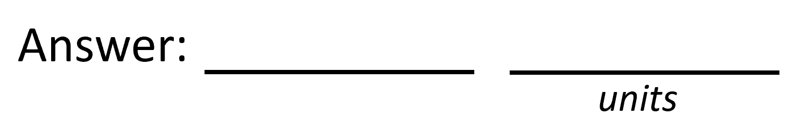
Data Analysis
Average velocity from table
Percent difference where $v_{sound}=343 m/s$
$$v_{avg}= \frac{v_{1}+v_{2}+v_{3}+v_{4}+v_{5}}{5}$$
335.21
m/s
$$Percent difference = \frac{\left|v_{avg}−v_{sound}\right|}{v_{sound}}×100$$
2.27
%

Slide 12
Conclusions
Briefly describe and explain the results.
  Answer: First, I calculated the average velocity using the data collection table, which If the experiment was done in cooler or drier conditions, that could explain why my calculated speed of sound was slightly lower than the accepted value. Since temperature and humidity both affect how fast sound travels, a small change in either could cause the results to differ from the expected 343 m/s. Between the known value (343 m/s) and my measured value (335.21 m/s) to assess the accuracy of the results and the extent of the discrepancy.
What is the dependence of temperature, humidity, and atmospheric pressure on the speed of sound? How does it affect the results?
  Answer: If the experiment was done in cooler or drier conditions, that could explain why my calculated speed of sound was slightly lower than the accepted value. Since temperature and humidity both affect how fast sound travels, a small change in either could cause the results to differ from the expected 343 m/s.

Slide 13
TECH204
Project Part 3
Gravitational Acceleration of a Free-Falling Object

Slide 14
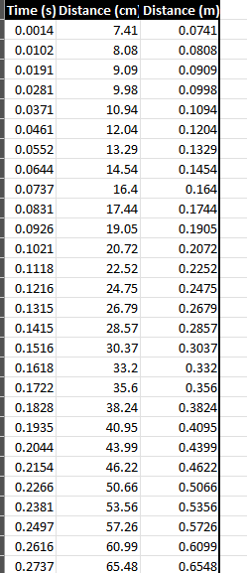
Excel Table
(Screenshot)
Include all values in the Excel table for a single trial showing the fall distance in centimeters and meters as a function of time

Slide 15
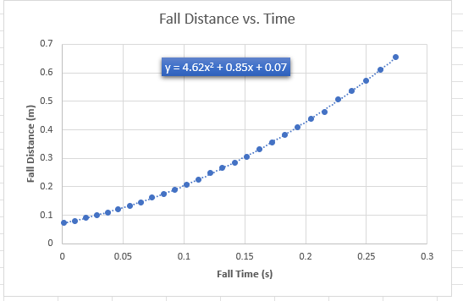
Excel Graph
(Screenshot)
Include Excel graph for a single trial showing the fall distance as a function of time.
Confirm that most data points fall along the curve fitting.
The x² coefficient should be between 2.5 and 7.5 such that its yields an acceleration value between 5 m/s² and 15 m/s²

Slide 16
Data Collection
Trial | x² coefficient value from curve fitting | Acceleration (m/s²) = 2* (x² coefficient)
1 | 4.6857 | 9.3714
2 | 5.0203 | 10.0406
3 | 4.6635 | 9.3270
4 | 4.6170 | 9.2340
5 | 4.7269 | 9.4538

Slide 17
Data Analysis
Average acceleration from table
Percent difference with $g=9.8 m/s^{2}$
$$a_{avg}= \frac{a_{1}+a_{2}+a_{3}+a_{4}+a_{5}}{5}$$
9.49
$$m/s^{2}$$
$$Percent difference =\frac{\left|a_{avg}−g\right|}{g}×100$$
3.21
%

Slide 18
Conclusions
Briefly describe and explain the results.
  Answer: The average acceleration came out to be 9.49 m/s², which gave us a percent difference of 3.21% compared to the actual value of gravity. This shows the experiment gave a pretty accurate estimate of gravitational acceleration. The small difference is likely from things like air resistance, timing errors, or sensor precision.
How much variation is there from trial to trial? What does this indicate about the uncertainty of the result?
  Answer: There’s a bit of variation from trial to trial, but overall, the values stay close to each other. This suggests that the uncertainty in the result is low, and that the setup and measurements were mostly consistent, with only minor differences probably caused by equipment limitations or small experimental errors.

Slide 19
TECH204
Project Part 4
Conservation of Energy of a Free-Falling Object

Slide 20
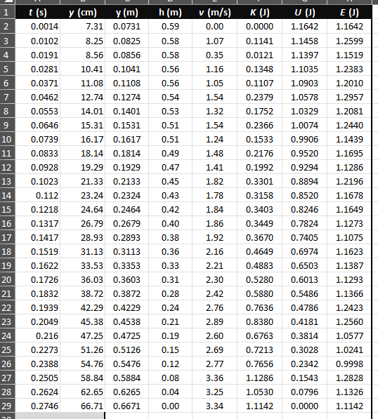
Excel Table
(Screenshot)
Include all values in the Excel table for a single trial showing the fall distance in centimeters and meters as a function of time with the values generated for kinetic energy K, potential energy U, and total mechanical energy E.

Slide 21
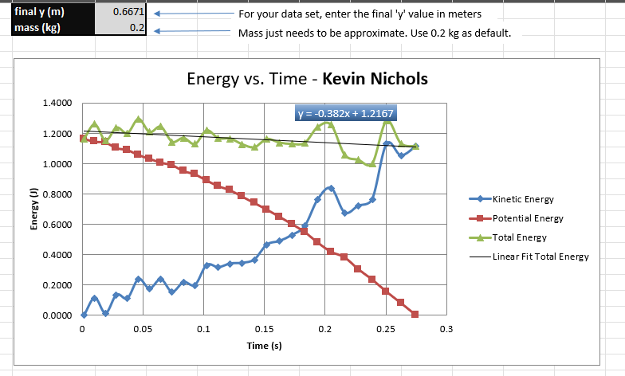
Excel Graph
(Screenshot)
Include Excel graph for a single trial showing the plots of the kinetic energy K, potential energy U, and total mechanical energy E as a function of time.
Must include your name in the title of the graph.

Slide 22
Data Analysis
Theoretical value of final velocity
Final velocity from experimental data (or largest velocity)
Percent difference
$h=y_{final}−y_{initial}=$
0.594
m
$v_{f}=\sqrt{2gh}=$
3.42
m/s
$v_{experimental}$ =
3.34
m/s
$$Percent difference =\frac{\left|v_{f}−v_{experimental}\right|}{v_{f}}×100$$
2.37
%

Slide 23
Conclusions
Discuss the key characteristics of the plot. Consider the points when potential energy U is maximum, U is minimum, kinetic energy K is maximum, K is minimum and when U and K are the same value. What is the significance of these points?
  Answer: As the object falls, potential energy decreases while kinetic energy increases, keeping total energy nearly constant. U is highest at the start, K is highest at the end, and they are equal halfway through. This shows energy is conserved during the fall.

Slide 24
TECH204
Project Part 5
Relationship between Linear and Rotational Motion

Slide 25
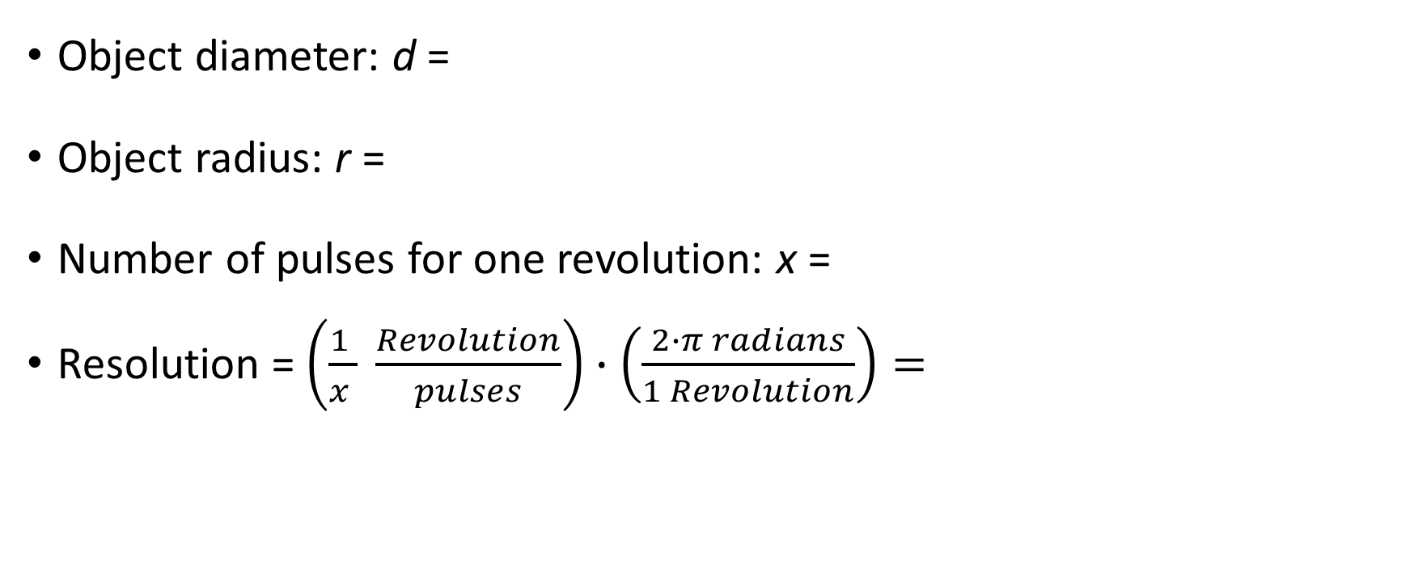
Data Collection
6.0
cm
Object diameter: d =
Object radius: r =
Number of pulses for one revolution: x =
Resolution = $\left(\frac{1 }{x } \frac{Revolution}{pulses}\right)∙\left(\frac{2∙π radians}{1 Revolution}\right)=$
3.0
cm
100
0.0628
Radians/pulse

Slide 26
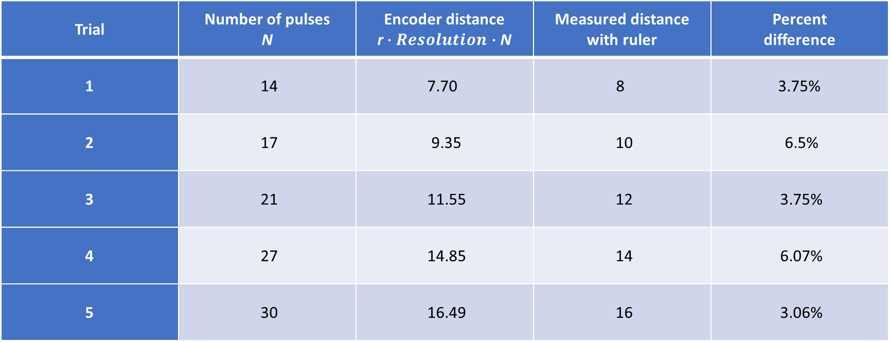
Data Analysis
Trial | Number of pulses N | Encoder distance r$∙Resolution∙$ N | Measured distance with ruler | Percent difference
1 | 14 | 7.70 | 8 | 3.75%
2 | 17 | 9.35 | 10 | 6.5%
3 | 21 | 11.55 | 12 | 3.75%
4 | 27 | 14.85 | 14 | 6.07%
5 | 30 | 16.49 | 16 | 3.06%

Slide 27
Conclusions
Briefly describe and explain the results.
  Answer: The encoder measurements closely matched the ruler measurements, with percent differences mostly under 6.5%, showing that the encoder system provides accurate distance data. Minor differences may be due to measurement error or sensor limitations.
What are some applications of this measuring technique? Could this measuring system be used to measure surfaces that are not flat?
  Answer: This technique is useful in robotics, automation, and wheel-based distance tracking. It may not be accurate on uneven or curved surfaces since the wheel might slip or not roll uniformly.

Slide 28
TECH204
Project Part 6
Observing the Hall Effect

Slide 29
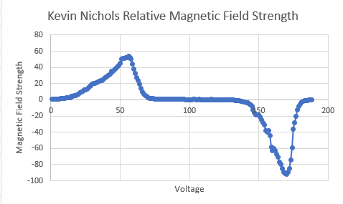
Excel Graph
(Screenshot)
Include Excel graph for a single trial of data plotted as a function of time.
Must include your name in the title of the graph.

Slide 30
Conclusions
Briefly describe and explain the results.
  Answer: The graph shows how the magnetic field changes across a magnet. The field rises to a peak (north pole), drops back down, then goes negative (south pole), and returns to zero. This pattern is what we expect when moving a sensor across a magnet — it shows both poles clearly.
Describe how the Hall sensor works. What are some applications for the Hall effect sensor?
Answer: A Hall sensor measures magnetic fields. When electricity flows through it and there's a magnetic field nearby, the sensor produces a small voltage. This voltage tells us how strong the magnetic field is.
Common uses:
Detecting if something is near (like a laptop lid)
Measuring how fast something is spinning (like wheels)
Checking the position of parts in machines or motors

Slide 31
Challenges
My biggest challenge in this project was making sure my calculations were correct.

Slide 32
Career Skills
Learning applied physics helps develop a wide range of valuable career skills, including:
Problem-Solving – Analyzing complex systems and finding practical solutions.
Critical Thinking – Interpreting data and evaluating outcomes logically.
Technical Skills – Using tools, sensors, and software common in engineering and tech.
Data Analysis – Gathering, interpreting, and presenting quantitative data.
Project Management – Planning experiments or builds, managing time and resources.
Communication – Explaining scientific ideas clearly in reports or presentations.
Collaboration – Working effectively in team settings, especially on technical projects.
Adaptability – Applying principles to new technologies or unexpected problems.
These skills are useful in careers like engineering, data science, software development, robotics, renewable energy, aerospace, and more.

